Slide 1
Student SURPLUS Website

Slide 2
CONTENT
Team
Motivation
Project Description
Modules
Timeline
Activity Diagram
Risk Management
Team Member Roles
Repository Policies

Slide 3
ABOUT TEAM
Team Name: DASH
Team Members: 1) Sri Sravya Tirupachur Comerica
2) Amisha Gadhia
3) Aboubakar Mountapmbeme
4) Haidi Chen

Slide 4
motivation
Some students face difficulties getting certain items they need for various reasons
On the other end, there are some students who own these items and are looking for people to take them out for free or for some little cash.
Thus we are motivated to provide a platform where they can easily exchange items they no longer need either for free or for cash

Slide 5
Project Description
The goal of the project is to develop a student surplus website which helps students to buy or sell items that they no longer need such as tables, beds, books and furniture just by posting a picture of the item on-site. It’s like a market place where students have the option to select the product, add them to the cart and checkout. The website also provides an additional security feature which helps students securely exchange the products, the students who are willing sell the items should contact the admin to avoid fraudulent postings on the site. Overall, the website provides students the ease of exchanging the unused items efficiently with added security.
Web Technologies: HTML 5, CSS3, JavaScript, JQuery and Bootstrap.
IDE: Eclipse
Operating System: Windows
Database: MySQL
Programming Language: Java
Server: Tomcat 9

Slide 6
Modules
User module
Registration module
Login module
Admin module
Category module
Product posting module
Search module
Buying module
Payment module
Rating and review module

Slide 7
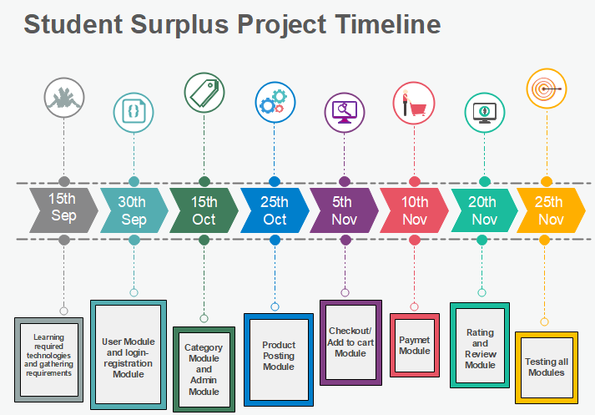
Timeline

Slide 8
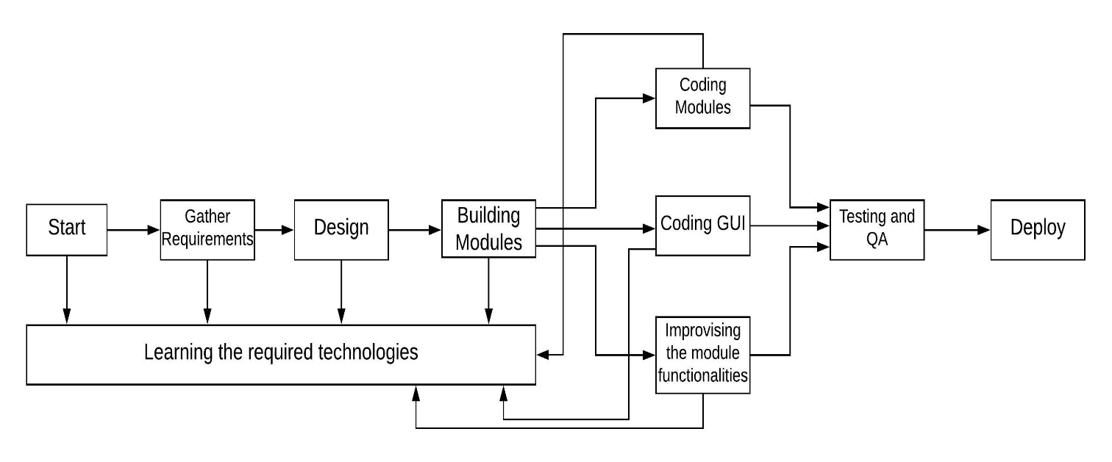
PERT Chart

Slide 9
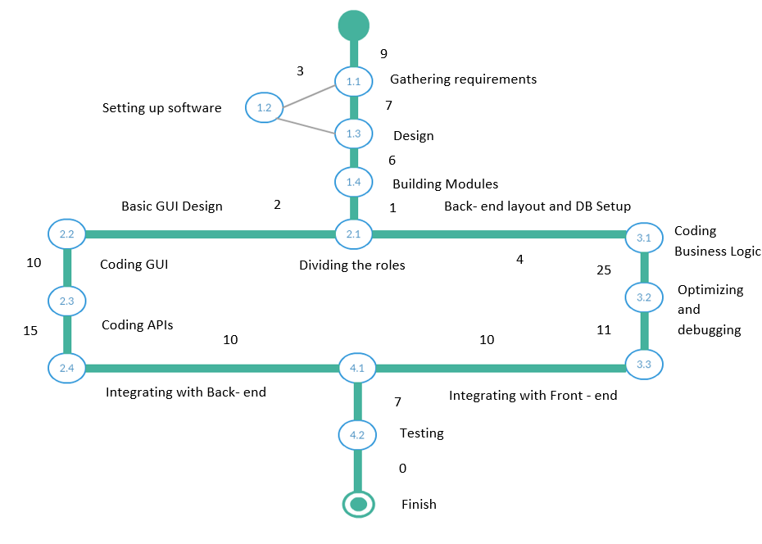
Activity diagram

Slide 10
Risk Management - generic risks
Risk: Not adhering to timeline (Schedule)
> We plan to check whether we are following the timeline or not.
> Otherwise, we plan on putting more hours into working to meet the scheduled deadlines.
Risk: Changes in requirements/ new requirements:
> When in need of new requirements or change in existing requirements.
> We plan on spending more time in meeting the expectations and delivering the components as scheduled.

Slide 11
Project risk – specific
Failure of Payment Method
Critical component of the system
We Plan to have an alternative payment policy between buyer and seller in case of failure
Experience of Team members with technology to use
Our Learning rate might have an effect on delivery timeline
We have started learning and if necessary, we will increase our coding hours.
Integrating the different modules together
Our module-based approach might present some problems during integration
We plan to study more than one integration technique/technology in case we our initial design fails

Slide 12
Team member roles
We divide roles according to whether a task is a frontend or a backend task.
All team members will work together during
The requirement gathering and analysis
the design of the GUI and project architecture
During the first Module:
Sri Sravya Tirupachur Comerica and Haidi Chen work on backend
Amisha Gadhia and Aboubakar Mountapmbeme work on frontend
Roles will be reassigned after the completion of the first module.
Depending on the work load, a team member might work on backend and frontend tasks within a module.

Slide 13
repository
Our Github repository is Structure as follows
Software-Engineering-Project
StudentSurplusSite (contains project source code)
Deliverables (group assignments in word)
PPT (PowerPoint presentations)
MeetingMinutes (Meeting minutes)
Readme.txt (text file that describes directory structure)

